Slide 1
Midterm REVIEW Jeopardy
APS106

Slide 2
Rules of the GAME
Form a team with your table or tables around you (sizes ~2-4)
Choose a team name for the scoreboard
Go to https://www.multibuzz.app
Enter the Room Code TQCWMG and your Team Name
If you get the answer right, you gain the points, and pick the next category
If you get the answer wrong, you lose the points, and the next person who buzzed in is up
Ask questions if you’re confused! Remember, if you’re confused, so are others!

Slide 3
Panel
THE GOOD, the BAD, and the FUNCTION
File Club
Containers
Classablanca
The Hitchhiker's Guide to Python
$250
$250
$250
$250
$250
$500
$500
$500
$500
$500
$750
$750
$750
$750
$750
$1000
$1000
$1000
$1000
$1000

Slide 4
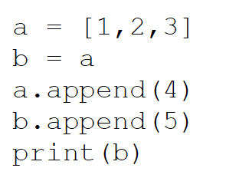
What is the result?
THE GOOD, the BAD, and the FUNCTION · $250
Question board

Slide 5

THE GOOD, the BAD, and the FUNCTION · $250
Question board

Slide 6
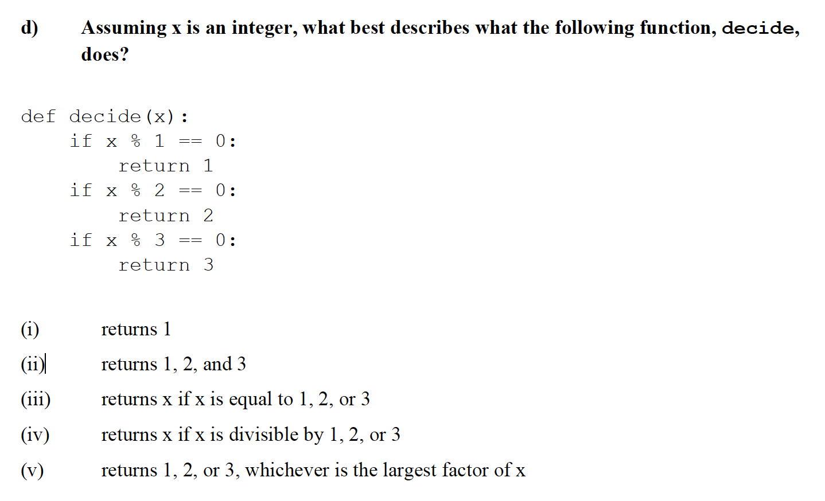
THE GOOD, the BAD, and the FUNCTION · $500
Question board

Slide 7
THE GOOD, the BAD, and the FUNCTION · $500
Question board

Slide 8
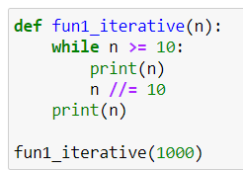
What is the output?
THE GOOD, the BAD, and the FUNCTION · $750
Question board

Slide 9

What is the output?
THE GOOD, the BAD, and the FUNCTION · $750
Question board

Slide 10
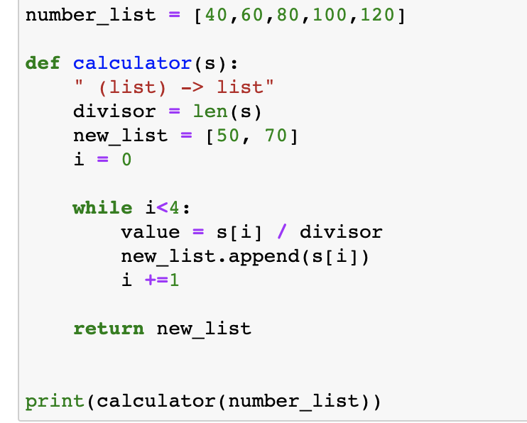
What is the output?
THE GOOD, the BAD, and the FUNCTION · $1000
Question board

Slide 11
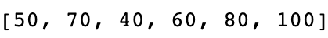
What is the output?
THE GOOD, the BAD, and the FUNCTION · $1000
Question board

Slide 12
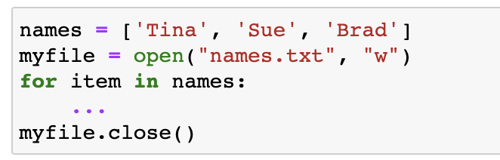

What is the missing line of code to write the names into names.txt?
File Club · $250
Question board

Slide 13
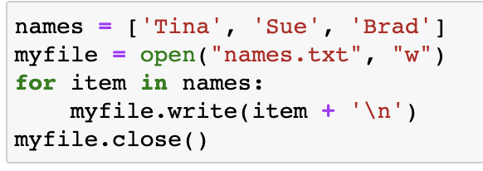
What is the missing line of code to write the names into names.txt?
File Club · $250
Question board

Slide 14
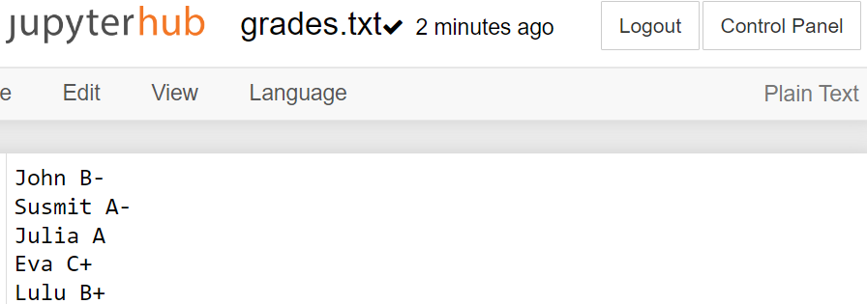
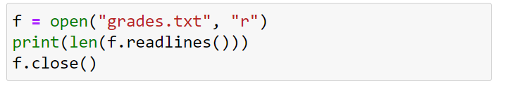
What is the output?
File Club · $500
Question board

Slide 15
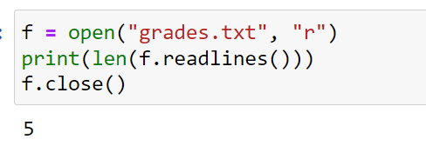
What is the output?
File Club · $500
Question board

Slide 16
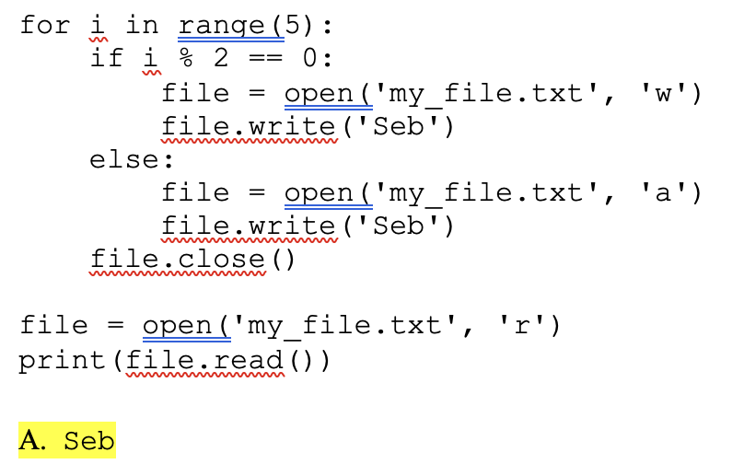
What is the output?
File Club · $750
Question board

Slide 17
What is the output?
File Club · $750
Question board

Slide 18
What is the output?
File Club · $1000
Question board

Slide 19
File Club · $1000
Question board

Slide 20
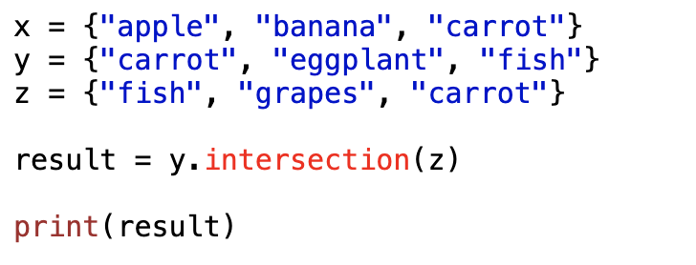
What is the output?
Fantastic Lists and Where to Find Them · $250
Question board
Notes:
Go to python notebook

Slide 21

What is the output?
Fantastic Lists and Where to Find Them · $250
Question board
Notes:
Go to python notebook

Slide 22
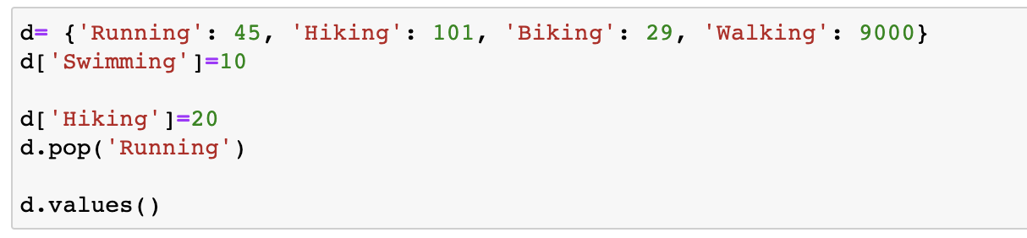
What will this code output?
Fantastic Lists and Where to Find Them · $500
Question board

Slide 23
What will this code output?
Fantastic Lists and Where to Find Them · $500
Question board

Slide 24
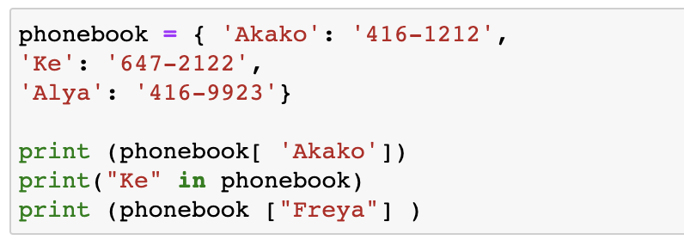
What will the code output?
Fantastic Lists and Where to Find Them · $750
Question board

Slide 25
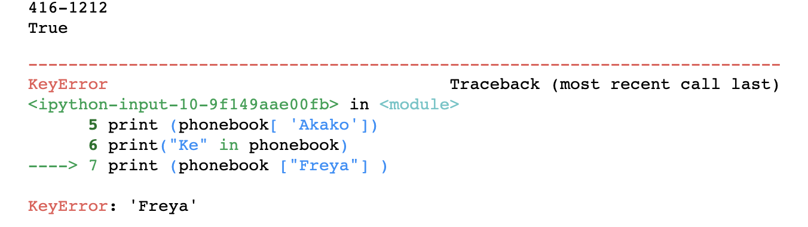
What will the code output?
Fantastic Lists and Where to Find Them · $750
Question board

Slide 26
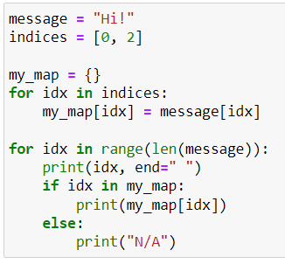
What is the output?
Fantastic Lists and Where to Find Them · $1000
Question board
Notes:
2

Slide 27

What is the output?
Fantastic Lists and Where to Find Them · $1000
Question board
Notes:
2

Slide 28
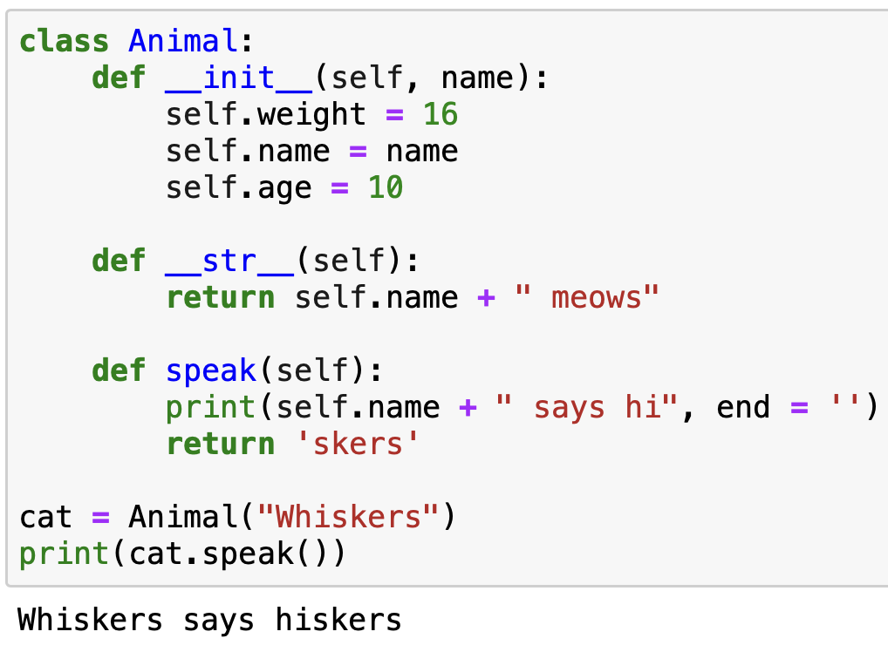
What is the output?
Classablanca · $250
Question board

Slide 29
What is the output?
Classablanca · $250
Question board

Slide 30
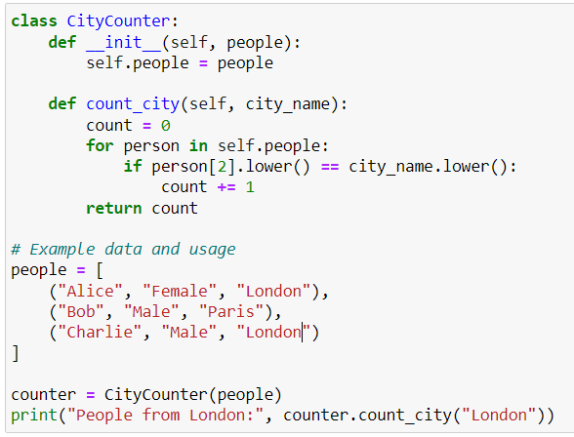
What is the output?
Classablanca · $500
Question board
Notes:
No output

Slide 31
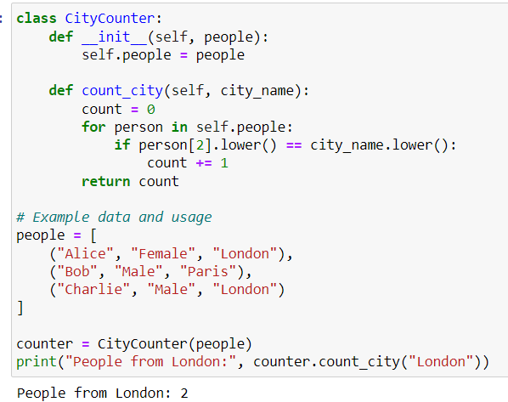
What is the output?
Classablanca · $500
Question board
Notes:
No output

Slide 32
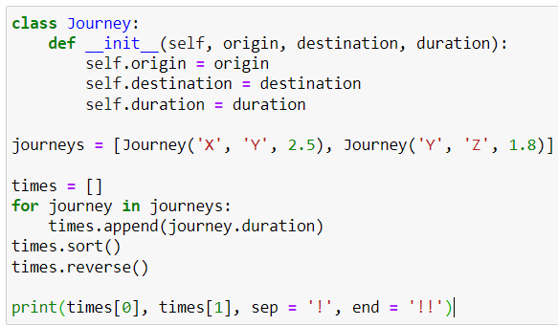
What is the output?
Classablanca· $750
Question board
Notes:
120

Slide 33
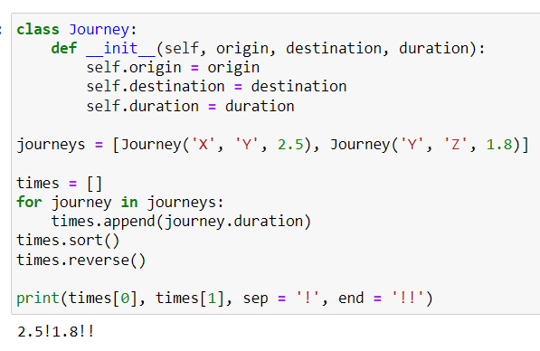
What is the output?
Classablanca· $750
Question board
Notes:
120

Slide 34
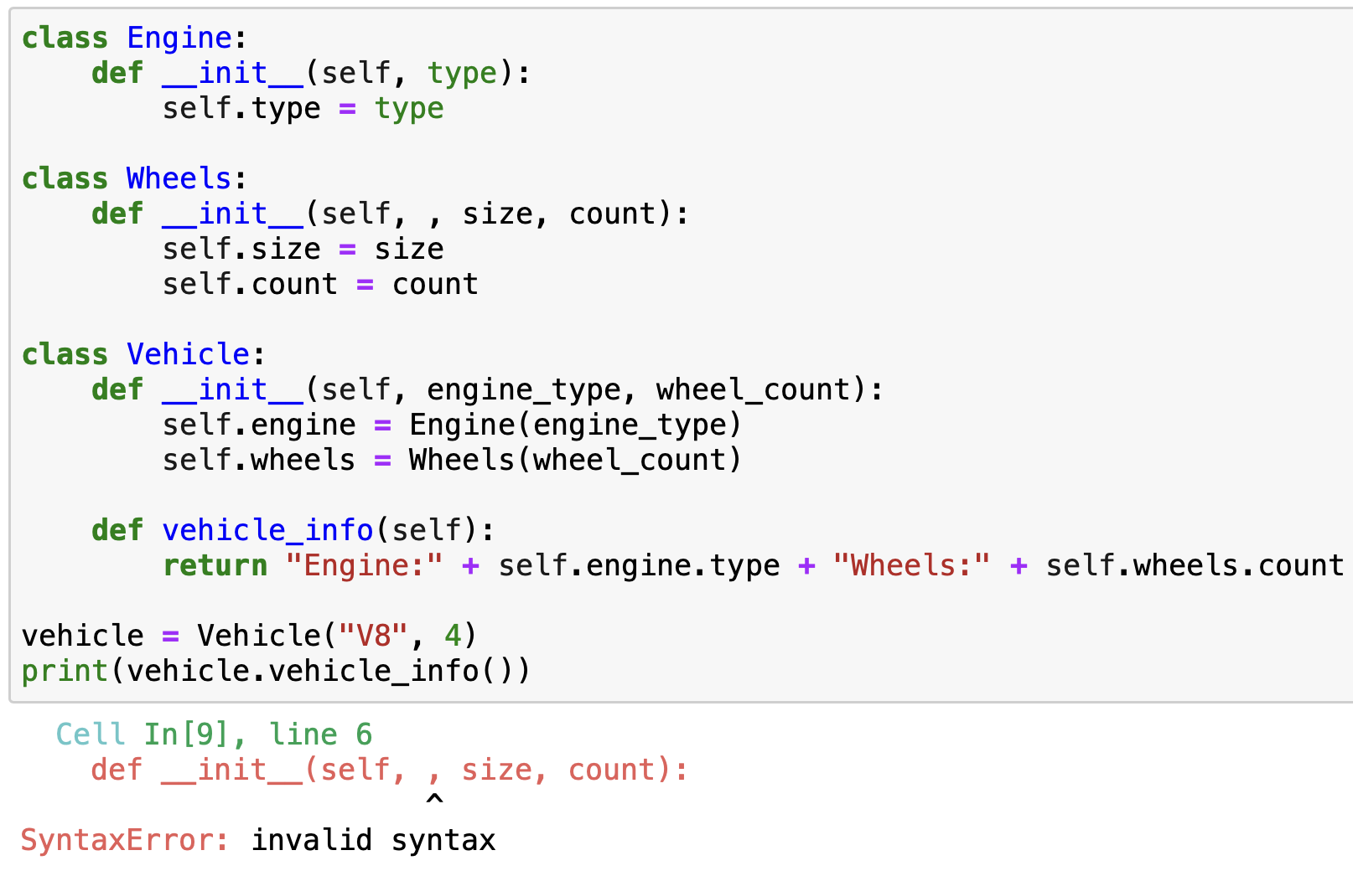
What is the output?
Classablanca · $1000
Question board
Notes:
C

Slide 35
What is the output?
Classablanca · $1000
Question board
Notes:
C

Slide 36
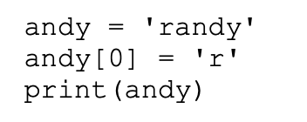
What is the output?
The Hitchhiker's Guide to Python · $250
Question board
Notes:
6

Slide 37
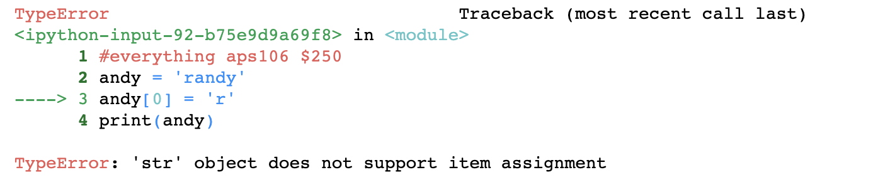
What is the output?
The Hitchhiker's Guide to Python · $250
Question board
Notes:
6

Slide 38
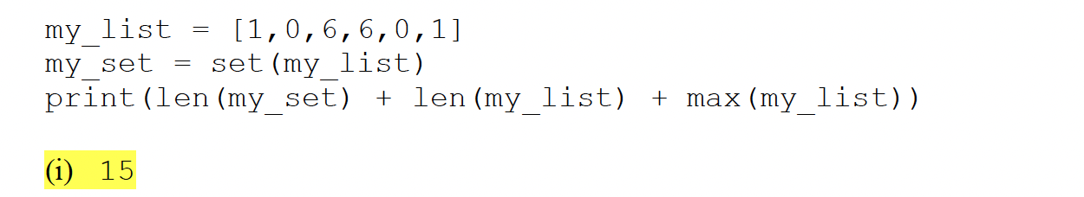
What is the output?
The Hitchhiker's Guide to Python · $500
Question board
Notes:
Infinite

Slide 39
What is the output?
The Hitchhiker's Guide to Python · $500
Question board
Notes:
Infinite

Slide 40
What is the output?
The Hitchhiker's Guide to Python · $750
Question board

Slide 41
What is the output?
The Hitchhiker's Guide to Python · $750
Question board

Slide 42
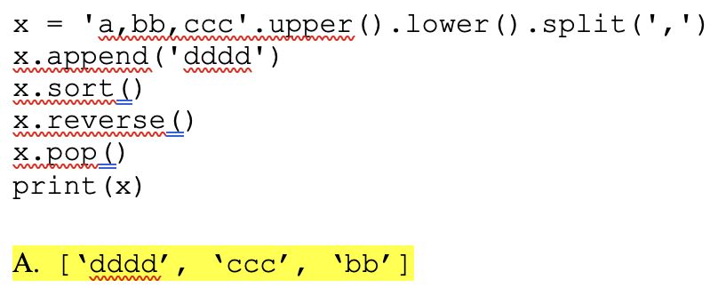
The Hitchhiker's Guide to Python · $1000
Question board
Notes:
21

Slide 43
The Hitchhiker's Guide to Python · $1000
Question board
Notes:
21

Slide 44
Final Jeopardy

Slide 45
Question 1 · FINAL JEOPARDY

Slide 46
Question 1· FINAL JEOPARDY

Slide 47
Question 2 · FINAL JEOPARDY

Slide 48
Question 2 · FINAL JEOPARDY

